Slide 1




NS2
Project Proposal
Md. Shahrukh Islam
Student ID: 1805098

Slide 2
The Paper:
The Peak-Hopper: A New End-to-End Retransmission Timer for Reliable Unicast Transport
Link: https://www.cs.helsinki.fi/u/gurtov/reiner/PeakHopper_draft0207.pdf

Slide 3
Overview
Modified mechanism for RTT calculation
TCP Retransmission Time Out (RTO) and Round-Trip Time (RTT)
Two RTO algorithm runs in parallel.
One is Short-Term History RTO.
Another one is Long-Term History RTO.

Slide 4
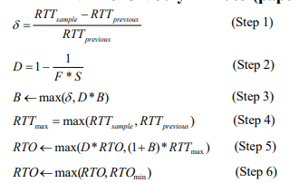
Calculating RTO [From the Paper]

Slide 5
Explanation
Step 1 | Having collected a new RTT sample, RTTsample(in the picture), we compare this value to the previous RTT sample collected, RTTprevious (in the picture), as shown in Step 1. We call the normalized change between these two samples δ. This is the measure of the short-term changes in RTT.
Step 2 | D is decay factor. D determines how rapidly the RTO is decayed. F is fade variable, which controls the speed of this decay (a high F gives a slow decay and a low F gives a high decay).

Slide 6
Explanation
Step 3 | We calculate a booster variable B. The booster variable determines how high the RTO should hop when a large RTT increase has been detected.
Step 4 | We set RTTmax to the maximum of the new RTT sample, RTTsample, and the previous RTT sample, RTTprevious. RTTmax is used to represent the short-term history of the RTT

Slide 7
Explanation
Step 5 | We set RTO to the maximum of a long-term history (represented by the term D*RTO ) and the short-term history (represented by the term ((1+B)*RTTmax).
Step 6 | we ensure that the RTO does not fall below the minimum allowed RTO.

Slide 8
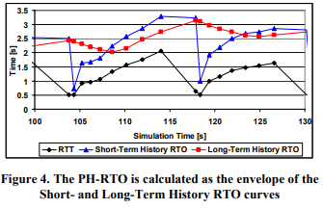
Expected Output

Slide 9
Thank you.

